Slide 1
Algebraic Topology and Distributed Computing part two
Maurice Herlihy
Brown University

Slide 2
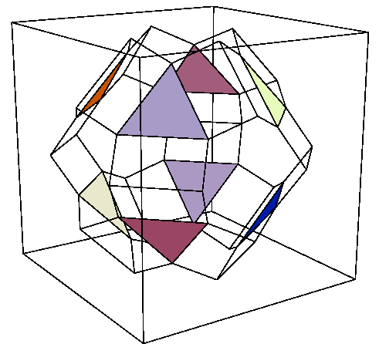
Proof Strategy
δ
Find topological “obstruction” to this simplicial map
Protocol complex
Output complex

Slide 3
Obstructions
n-sphere
(n+1)-disk

Slide 4
No Holes in Dimension n
every continuous n-sphere map extends to
(n+1)-disk
f
F

Slide 5
Connectivity
A complex C is n-connected if it has no holes in dimension n or less.
  dimension -1: non-empty (by convention)
  dimension 0: connected
  dimension 1: simply connected
(Homotopy groups are trivial.)

Slide 6
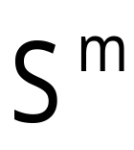
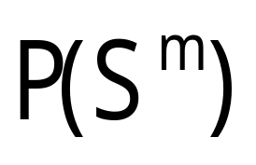
Protocol as Operator
input simplex: fix m+1 processes and their inputs
protocol complex: only these processes take steps

Slide 7
Connectivity of P(S)
Dimension below which holes vanish
higher dimension:
  more obstructions
  more tasks impossible
lower dimension:
  fewer obstructions
  fewer tasks impossible

Slide 8
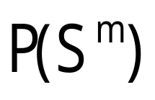
Theorem
synchronous message-passing model
  r rounds
  at most k failures per round
is (n-rk+1)-connected
  connectivity drops with each round
  implies (n-1)-round consensus bound

Slide 9
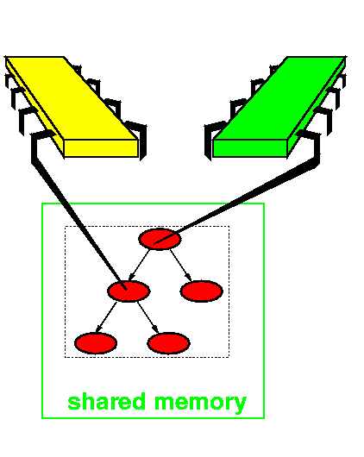
Shared Memory Model

Slide 10
Shared Memory Model
Processes share memory m[0…n]
  unbounded size (for lower bounds)
each P can
  atomically write to m[P]
  atomically scan (read) all of m
equivalent to usual read/write models

Slide 11
Asynchronous Wait-Free
Asynchronous
  arbitrary delays
  e.g., interrupts, page faults, etc.
wait-free
  all but one process can halt
failed and slow indistinguishable

Slide 12
Generic R/W Protocol
Number of rounds
s = empty sequence
for (i=0; i<r; i++) {
s = s + scan(m)
m[P] = s;
}
return δ(s)
Decision map

Slide 13
One-Round Protocol Complex
0
00
00
0
P runs solo
P and Q see one another
Q runs solo

Slide 14
One-Round Protocol Complex
R runs solo
(Some simplexes omitted for clarity)
P and Q run solo

Slide 15
Theorem
Wait-Free R/W Protocol Complexes
  are n-connected
  (no holes in any dimension)
  no matter how long the protocol runs
Next: an application

Slide 16
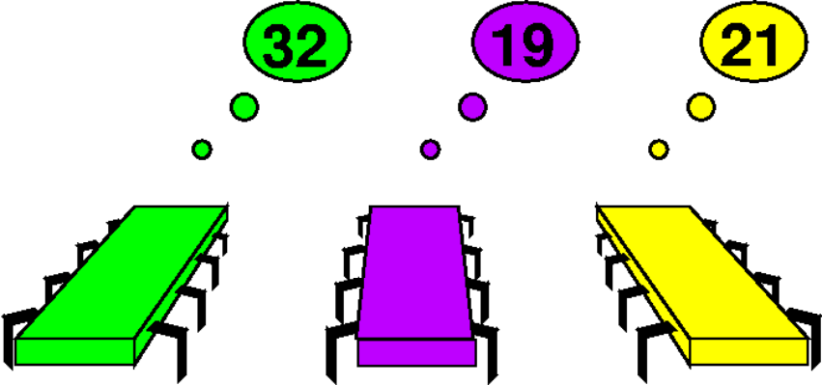
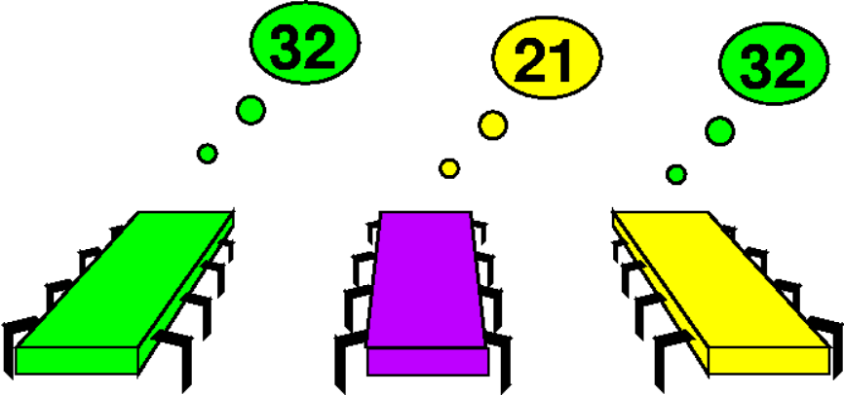
The k-Set Agreement Task
Before: private inputs
After: agree on k inputs

Slide 17
Output Complex for 3-Process 2-Set Agreement
0 and 1
1 and 2
2 and 3

Slide 18
Set Agreement
Proposed by Soma Chaudhuri 90
generalization of consensus
does wait-free R/W protocol exist?
  Open problem until 1993
  [Borowsky Gafni], [Herlihy Shavit], [Saks Zaharoglou]

Slide 19
Proof Outline
Assume protocol exists
show incompatibilities between
  protocol complex
  output complex
some execution must decide too many distinct values

Slide 20
Sperner’s Lemma
Subdivide a simplex
give each “corner” a distinct color
each edge vertex a corner color
interior vertexes any corner color

Slide 21
Sperner’s Lemma
At least one simplex has all colors

Slide 22
Input Simplex & Protocol Complex
Each process colored with distinct input
Each vertex colored with decision

Slide 23
Protocol Complex for One Process Execution
P( ) =
single vertex
labeled with matching color
P( ) =
P( ) =

Slide 24
Protocol Complex for Two-Process Executions
Protocol complex is connected
there is a path from P( ) to P( )
all vertexes labeled with red or yellow
P( ) =

Slide 25
Protocol Complexes for all Two-Process Executions
P( )
P( )
P( )

Slide 26
Full Protocol Complex
Because complex is simply connected
we can “fill in” edge paths
vertexes colored with input colors
P( )

Slide 27
Apply Sperner’s Lemma
some simplex has all three colors
that simplex is a protocol execution that decides three values!

Slide 28
Augmented Shared Memory
Real multiprocessors provide additional atomic synchronization
  test&set
  compare&swap
  load-linked/store-conditional

Slide 29
Example: Test&Set
Test&set(int v) {
int temp = v;
v = 1;
return temp;
}
First gets 0, rest get 1

Slide 30
Test&Set Protocol Complex
0
3 processes
First gets 0
Rest get 1
multi-round: Sierpinski triangle
1
1
0
1
0

Slide 31
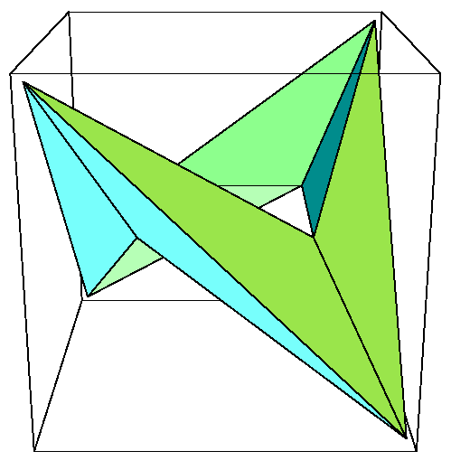
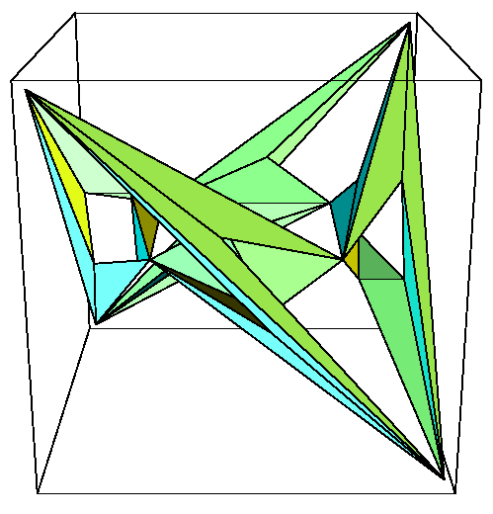
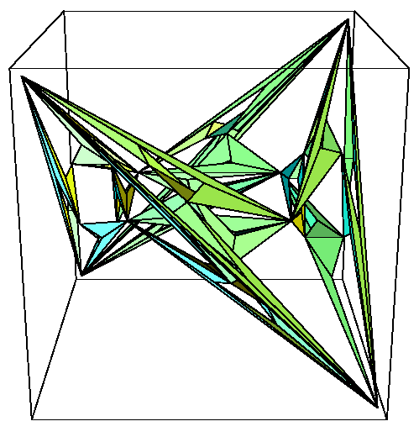
Other Test&Set Protocol Complexes
Connected, not simply connected

Slide 32
Theorem
Wait-Free T&S Protocol Complexes
  are all (n-1)-connected
  more powerful than read/write
  but still no 3-process consensus!
Similar results hold for other atomic synchronization operations

Slide 33
Summary
“Power” of model of computation
  connectivity of protocol complexes
  dimension below which holes vanish
So far
  defined model
  one application
Next: computing connectivity

